Slide 1
TEA: Enabling State-Intensive Network Functions on Programmable Switches
Daehyeok Kim§‡
Zaoxing Liu§, Yibo Zhu^, Changhoon Kim†, Jeongkeun Lee†, Vyas Sekar§, Srinivasan Seshan§
§Carnegie Mellon University
†Intel, Barefoot Switch Division
‡Microsoft Research
^ByteDance Inc

Slide 2
Network functions in the network
Network functions (NFs) are an essential component
E.g., Load balancer, Firewall, Network address translator (NAT), …
NF performance and scalability are key challenges

Slide 3
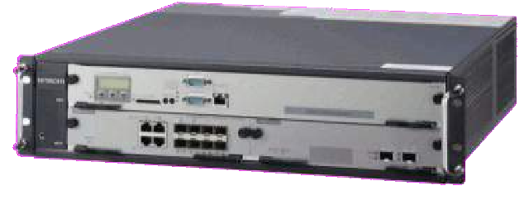


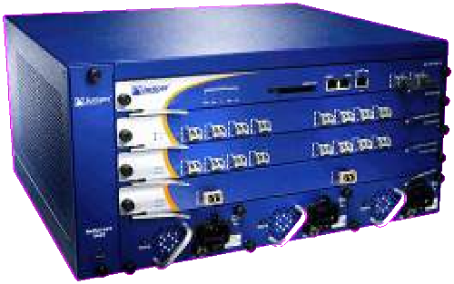
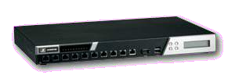




Approaches to deploying network functions
NAT
NAT
LB
FW
Virtualization layer
NAT | LB | FW
Programmable switch ASIC
FW
LB
Commodity server
Standalone hardware Fixed-function Performance: O(10 Gbps) Memory: O(10GB) DRAM
Price: >$40K
Server-based Software (NFV)
Programmable Performance: O(10 Gbps) Memory: O(10GB) DRAM
Price: $3K
Switch-based NF Programmable Performance: O(1 Tbps) Memory: O(10MB) SRAM
Price: $10K
Notes:
Terabyte per second level
Implementing them on a cluster of commodity servers

Slide 4




Problem: serving demanding workloads
None of the options can efficiently serve demanding workloads!
Millions of concurrent flows (O(100MB)) + high traffic rate (> 1 Tbps)
Cost- and energy-inefficient ☹
Promising but cannot maintain flow state ☹
NAT
NAT LB FW
_{FW LB} Virtualization layer Commodity server
NAT LB FW
Programmable switch ASIC
Standalone hardware Fixed-function Performance: O(10 Gbps) Memory: O(10GB) DRAM
Price: >$40K
Server-based Software (NFV)
Programmable Performance: O(10 Gbps) Memory: O(10GB) DRAM
Price: $3K
Switch-based NF Programmable Performance: O(1 Tbps) Memory: O(10MB) SRAM
Price: $10K

Slide 5
Root cause: limited on-chip SRAM
Limited on-chip SRAM space: O(10MB)
Infeasible to maintain large flow state within on-chip SRAM
E.g., LB state for 10M flows requires ≈100MB
Adding more SRAM would be too expensive ☹
Can we leverage larger and cheaper DRAM near switch ASICs?

Slide 6



DRAM available on a switch board
Option #1:
DRAM on the switch control plane
Option #2:
On-board, off-chip DRAM
Switch board
Switch control plane
DRAM
Switch board
Switch control plane
CPU
Switch data plane (ASIC)
Pipeline stages On-chip SRAM
Extension
Switch data plane (ASIC)
Pipeline stages On-chip SRAM
PCIe
DRAM
Limited scalability in terms of size and access bandwidth
High cost
Notes:
ASIC on the data plane can access DRAM on the control plane by PCIe channel. But the PCIe channel has a limited bandwidth, which is
lower than the ASIC’s per-port bandwidth.
The paper states that the on-board off-chip DRAM has limitation on the size and memory access bandwidth

Slide 7


Opportunity: DRAM on commodity servers
Switch board
Switch control plane
Switch data plane (ASIC)
Pipeline stages On-chip SRAM
Server
DRAM
+ Scalable memory size and bandwidth
+ Low cost

Slide 8


Table Extension Architecture (TEA)
Table lookups with low and predictable latency
and scalable throughput
Switch board
Switch control plane
APIs that allow easy integration with NFs
Key Value
Switch data plane (ASIC)
Server
DRAM
Pipeline stages
On-chip SRAM
Virtual table abstraction for state-intensive NFs using external DRAM on servers

Slide 9
Outline
Motivation
TEA design
Results

Slide 10





TEA design overview
Developer
Switch board
Switch control plane
+ TEA P4 API
NF Impl.
Switch data plane (ASIC)
Server
DRAM
Binary
Pipeline stages
P4 Compiler
On-chip SRAM

Slide 11



Challenge 1:
Enabling external DRAM access from switch ASIC
Strawman: accessing external DRAM via the control plane
High and unpredictable latency ☹
Switch board
Switch control plane
Server
Switch data plane (ASIC)
Limited access bandwidth☹
Packet
DRAM
On-chip SRAM
11

Slide 12




Challenge 1:
Enabling external DRAM access from switch ASIC
Switch board
Switch control plane
Switch data plane (ASIC)
Server
DRAM
Packet
On-chip SRAM
How to enable switch ASIC to directly access external DRAM without CPUs and hardware modifications?
11

Slide 13




Challenge 2:
Enabling single round-trip table lookup
Switch board
Switch control plane
Key Value
5-tuple
Addr.
Server
DRAM
Switch data plane (ASIC)
Packet
On-chip SRAM
How to ensure a correct table entry can be retrieved
in a single memory access?

Slide 14


Challenge 3: Deferred packet processing
Switch board
Switch control plane
Key Value
5-tuple
Addr.
Server
DRAM
Switch data plane (ASIC)
Packet
On-chip SRAM
How to defer packet processing during lookups
without stalling the pipeline or buffering at the switch?

Slide 15






Challenge 4: Scaling TEA with multiple servers
With a single server, scalability and availability can be limited
Switch board
Switch control plane
A single server can fail
Switch data plane (ASIC)
Server
DRAM
Packet
On-chip SRAM
Access bandwidth is limited to a single link
14

Slide 16






Challenge 4: Scaling TEA with multiple servers
Switch board
Switch control plane
How to deal with servers’ availability changes?
Switch data plane (ASIC)
Server
DRAM
Packet
On-chip SRAM
How to balance access loads across servers?
14

Slide 17


Challenge 1:
How to access external DRAM in the data plane?
Switch board
Switch control plane
Switch data plane (ASIC)
Server
DRAM
Packet
On-chip SRAM
Switch ASICs do not have direct external DRAM access capability!
Is it possible to enable ASICs to access external DRAM
without hardware modifications and CPU involvement?

Slide 18
Direct Memory Access(DMA)
DMA allows certain hardware subsystems to access main system memory independently
of the CPU
PIO (Programmed Input/Output) Data transfer
Memory -> peripheral 1
Processor
System Bus
Memory
Peripheral 1
Peripheral 2

Slide 19
Direct Memory Access(DMA)
DMA allows certain hardware subsystems to access main system memory independently
of the CPU
DMA Data transfer
Processor
System Bus
Memory
DMA controller
Peripheral 1
Peripheral 2

Slide 20
Direct Memory Access(DMA)
DMA allows certain hardware subsystems to access main system memory independently
of the CPU
Peripheral 1 request the service of DMA
DMA controller requests for the buses
DMA gets the buses and activates DMAK
DMA starts to transfer data from memory to peripheral 1
DMA tells the CPU it finishes
DMA Data transfer
Arbitrator
Req
Processor
Grant
Grant
System Bus
Req
Memory
DMA controller
Peripheral 1
Peripheral 2

Slide 21
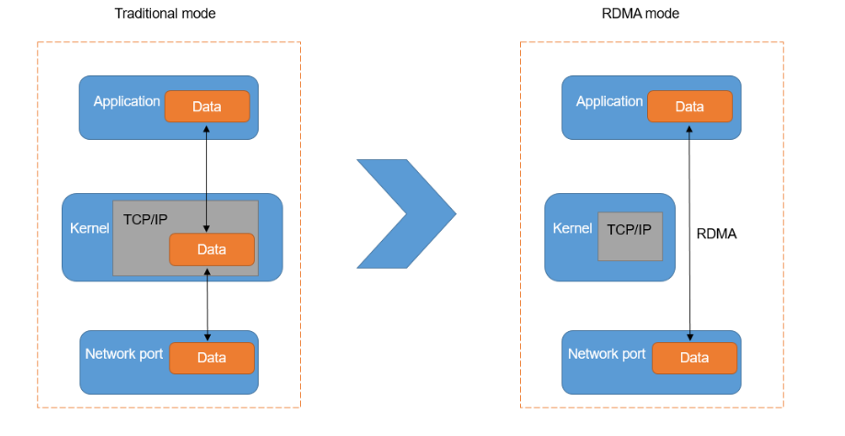
Remote Direct Memory Access(RDMA)
RDMA is a direct memory access from the memory of one computer into that of another
without involving either one's operating system.

Slide 22


Enabling RDMA in the switch data plane
Key idea: Crafting RDMA packets using ASIC’s programmability
1. A packet comes into the pipeline
Switch board
Switch control plane
Switch data plane (ASIC)
Server
DRAM
Packet
On-chip SRAM
16

Slide 23
Enabling RDMA in the switch data plane
Key idea: Crafting RDMA packets using ASIC’s programmability
1. A packet comes into the pipeline
Switch board
Switch control plane
2. The ASIC adds RDMA headers to craft an RDMA request
Switch data plane (ASIC)
RDMA-H Packet
On-chip SRAM
Server
DRAM
16

Slide 24
Enabling RDMA in the switch data plane
Key idea: Crafting RDMA packets using ASIC’s programmability
1. A packet comes into the pipeline
Switch board
Switch control plane
2. The ASIC adds RDMA headers to craft an RDMA request
Switch data plane (ASIC)
Server
RDMA-H
Payload
DRAM
3. The server NIC replies as it would for any standard RDMA request
On-chip SRAM
16

Slide 25
Enabling RDMA in the switch data plane
Key idea: Crafting RDMA packets using ASIC’s programmability
1. A packet comes into the pipeline
Switch board
Switch control plane
2. The ASIC adds RDMA headers to craft an RDMA request
Switch data plane (ASIC)
Server
DRAM
Payload
3. The server NIC replies as it would for any standard RDMA request
On-chip SRAM
4. The ASIC parses the response
16

Slide 26
Enabling RDMA in the switch data plane
Key idea: Crafting RDMA packets using ASIC’s programmability
1. A packet comes into the pipeline
Switch board
Switch control plane
2. The ASIC adds RDMA headers to craft an RDMA request
Switch data plane (ASIC)
Server
DRAM
Payload
3. The server NIC replies as it would for any standard RDMA
On-chip SRAM
4. The ASIC parses the response
Simple switch-side flow control prevents buffer overflows at the NIC!
-> simplified transport is enough
16

Slide 27
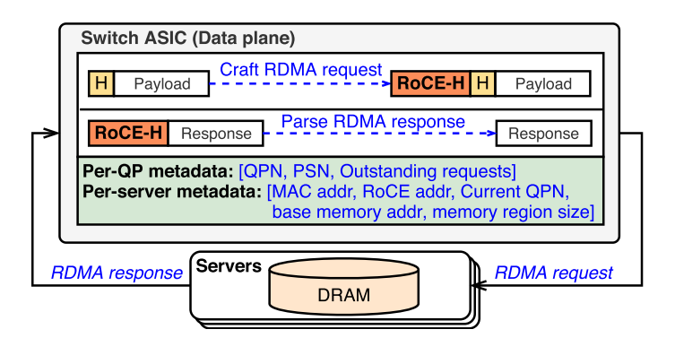
Enabling RDMA in the switch data plane
RoCE: RDMA over converged Ethernet
The needed metadata is provided via the control plane in advance

Slide 28




Challenge 2: Single round-trip table lookups
Switch board
Switch control plane
Switch data plane (ASIC)
Server
DRAM
Packet
On-chip SRAM
RDMA read takes ~2μs: multiple accesses can result in
high and unpredictable table lookup latency ☹
Can we enable external table lookups in a single round trip?
i.e., we need O(1) lookup mechanism

Slide 29


Cuckoo hashing as a potential approach
Switch board
Switch control plane
Switch data plane (ASIC)
On-chip SRAM
Server
DRAM
Packet
Cuckoo hash table in DRAM
18

Slide 30


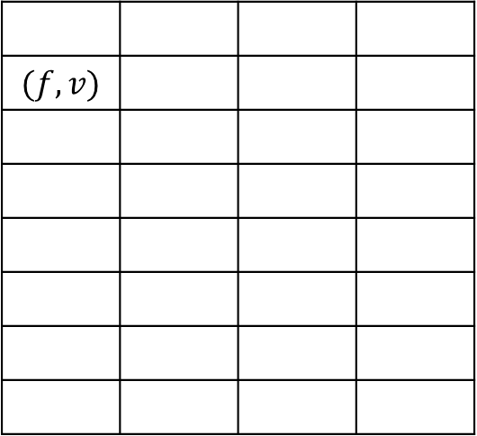

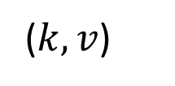
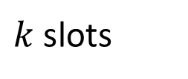
Cuckoo Hash Table
$k$ slots
$m$ buckets
$$(f,v)$$
$$h_{1}(k)$$
($k,v$)
$$h_{2}(k)$$

Slide 31
Cuckoo hashing as a potential approach
Switch board
Switch control plane
Switch data plane (ASIC)
(x)
Server
DRAM
hash
1
Packet
On-chip SRAM
hash
2
(x)
Cuckoo hash table in DRAM
Can we enable table lookup with a single memory access?
18

Slide 32


TEA-table: lookup data structure
Designed for improving cache hit rate in software switch [Zhuo’19*]
Key idea: Repurposing bounded linear probing (BLP)
Switch board
Switch control plane
Switch data plane (ASIC)
On-chip SRAM
Server
DRAM
Packet
TEA-table in DRAM
*Dong Zhou. Data Structure Engineering for High Performance Software Packet Processing. Ph.D. Dissertation. Carnegie Mellon University, 2019.
19

Slide 33


TEA-table: lookup data structure
Key idea: Repurposing bounded linear probing (BLP)
Trading space efficiency
Switch board
Switch control plane
for contiguous allocation
Server
DRAM
Switch data plane (ASIC)
Packet
On-chip SRAM
TEA-table in DRAM
Colliding entries are stored in the switch SRAM
19

Slide 34


TEA-table: lookup data structure
Key idea: Repurposing bounded linear probing (BLP)
Can read two buckets in one RDMA read!
Switch board
Switch control plane
Server
DRAM
Switch data plane (ASIC)
hash (x)
Packet
On-chip SRAM
TEA-table in DRAM
19

Slide 35




Challenge 3: Deferred packet processing
Switch board
Switch control plane
Switch data plane (ASIC)
Server
DRAM
Packet
On-chip SRAM
Packet processing needs to be
deferred until a lookup completes
Can we defer only a select packet without stalling the pipeline?

Slide 36


Offloading packet store to TEA-table for asynchronous packet processing
Idea #1: Employing scratchpad in TEA-table to buffer packets
Switch board
Switch control plane
Scratchpad
Switch data plane (ASIC)
Server
DRAM
Packet
On-chip SRAM
TEA-table in DRAM
21

Slide 37
Offloading packet store to TEA-table for asynchronous packet processing
Idea #1: Employing scratchpad in TEA-table to buffer packets
Switch board
Switch control plane
Scratchpad
 |  | Packet
Switch data plane (ASIC)
Server
DRAM
RDMA-Write Packet
On-chip SRAM
TEA-table in DRAM
21

Slide 38

Offloading packet store to TEA-table for asynchronous packet processing
Idea #1: Employing scratchpad in TEA-table to buffer packets
Switch board
Switch control plane
Scratchpad
Packet
Switch data plane (ASIC)
Server
DRAM
RDMA-Read
On-chip SRAM
TEA-table in DRAM
21

Slide 39

Offloading packet store to TEA-table for asynchronous packet processing
Idea #1: Employing scratchpad in TEA-table to buffer packets
Switch board
Switch control plane
Scratchpad
Packet
Switch data plane (ASIC)
Server
DRAM
Packet
TEA-table in DRAM
On-chip
Due to the ASIC’s parser limitation, the original packet and the bucket cannot be parsed
Notes:
High- speed switching ASICs usually can parse only the first few hundreds of bytes in each packet.

Slide 40


Offloading packet store to TEA-table for asynchronous packet processing
Idea #2: Employing shadow table in TEA-table
Switch board
Switch control plane
Scratchpad
 |  |  |  | Packet
Switch data plane (ASIC)
Server
DRAM
On-chip SRAM
Shadow table
Slightly increase of DRAM usage
22

Slide 41


Offloading packet store to TEA-table for asynchronous packet processing
Idea #2: Employing shadow table in TEA-table
Switch board
Switch control plane
Scratchpad
Packet
Switch data plane (ASIC)
Server
DRAM
Packet
On-chip SRAM
The ASIC can parse the buckets and process the packet
with a right table entry ☺
Shadow table
22

Slide 42


Challenge 4: Scaling TEA with multiple servers
Switch board
Switch control plane
Repurpose ASICs’ capability for reacting servers’ availability changes
Switch data plane (ASIC)
Server
DRAM
Packet
On-chip SRAM
Check utilization and port status by repurposing the meter and packet generator engine of the switch ASIC
Split hash tables into N sub-tables and distribute them into N servers
Small on-chip cache for load balancing and higher throughput: cache at least $O(NlogN)$ popular packets (N is the number of servers)
Notes:
Control plane to check link utilization and port status; utilize meter and packet generator engine of ASIC to check the state of servers

Slide 43


Putting it all together
TEA provides a virtual table abstraction to state-intensive NFs
Switch board
Switch control plane
Repurposing BLP for constant time lookup
Switch data plane (ASIC)
Server
DRAM
Small on-chip cache
for scalability
Packet
On-chip SRAM
Offloading packet store for async. packet processing
Leveraging programmability of ASICs
for accessing external DRAM in the data plane

Slide 44
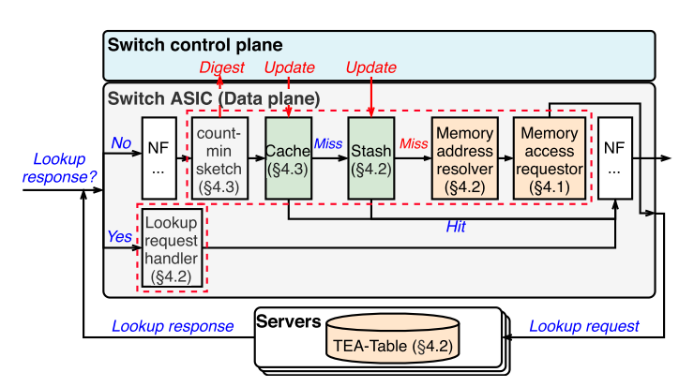
Putting it all together

Slide 45
Outline
Motivation
TEA design
Results

Slide 46
Implementation and evaluation setup
Implemented TEA API as P4 modules (aka. control block in P4)
Implemented canonical NFs including NAT and stateful firewall
- Load 10 million table entries
Testbed setup: Tofino-based switch + 12 servers with RDMA NICs

Slide 47
Does TEA access channel provide low and predictable lookup latency?
3
TEA RDMA-read
Latency (us)
2
1
0
64
128
256 512
Packet size (bytes)
1024
1500
Each lookup takes 1.8-2.2 us and the latency grows with the packet size

Slide 48
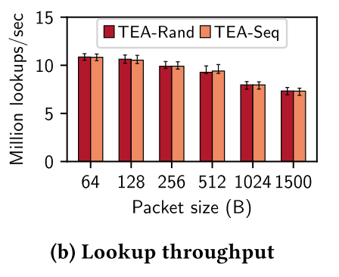
Does TEA access channel provide low and predictable lookup latency?
The server NIC can handle 7.3-10.9 million lookups per second

Slide 49
Does TEA provide scalable throughput?
150
No cache
Uniform
α=0.95
^{α=0.99} Traffic generation rate
Million lookups / second
100
50
0
1
2 4
Number of DRAM servers
8
Notes:
The skewness of the flow and cache influences the reuslt

Slide 50
Other results
Cost efficiency of TEA-enabled NFs compared to server- based counterparts.
Handling server failures within a second with a slight throughput degradation
Less than 9% of switch ASIC resource usage
See paper for more details!

Slide 51
Conclusion
Limited on-chip memory restricts potentials of switch-based NFs
Table Extension Architecture for Programmable Switches:
RDMA-based external DRAM access
BLP-based efficient lookup table structure
Asynchronous packet processing by offloading packet store
Small on-chip cache for scalability
Provides low and predictable latency with scalable throughput
Latency: 1.8 - 2.2 μs
Throughput: 138 million lookups/sec with 8 servers

Slide 52


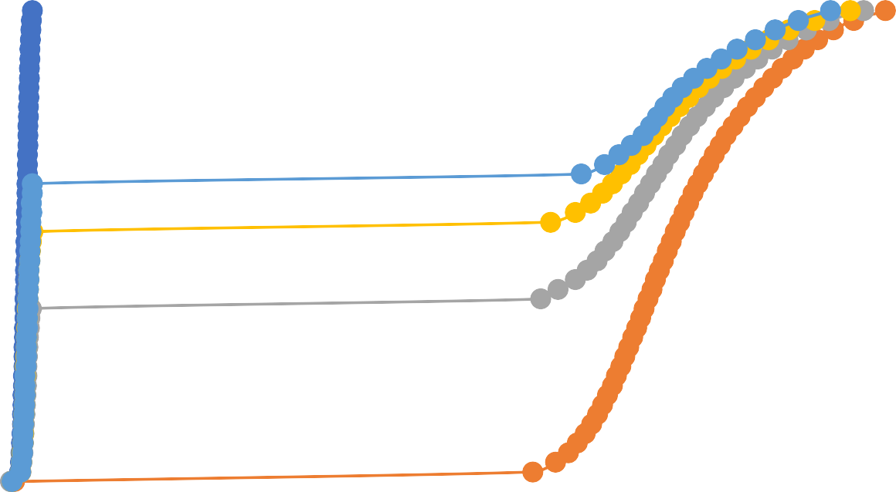
How does TEA affect NF processing latency?
Flow size skewness (α) affects on-chip cache hit rate
Baseline (SRAM only) Uniform α=0.9 α=0.99 Real 1
CDF
0.5
Served by on-chip cache
Served by TEA-table
0
0
1 2
Processing latency (μs)
3
Notes:
Navy blue

